Slide 1

PREDICT HOTEL BOOKING CANCELATIONS
Q CONSULTING
TONGJIUZHOU LIU
AMELIE LANGENSTEIN
NINA URBANČIČ
LAURA CUNA

Slide 2




AGENDA
01
02
03
BUSINESS UNDERSTANDING
EXPLORATORY DATA ANALYSIS
04
05
DATA
PREPARATION
MODELING
MODEL
DEPLOYMENT

Slide 3
01
02
03
BUSINESS UNDERSTANDING
EXPLORATORY DATA ANALYSIS
04
05
DATA
PREPARATION
MODELING
MODEL
DEPLOYMENT

Slide 4






BUSINESS UNDERSTANDING
01
THE PROBLEM
2018 cancellation rate 40%
business meeting changes
free cancellation policies
deal seeking customers
dependency on weather conditions
online travel agencies OTAs
illness of guests
overbooking

Slide 5
BUSINESS UNDERSTANDING
01
BUSINESS OBJECTIVE
Minimize
costs
Adjust offer according to net demand
reduce cancellation to 20%
Maximize
revenue
Reduces risks of overbooking or vacant rooms
Improve
reputation

Slide 6
BUSINESS UNDERSTANDING
01
DATA MINING GOAL
build a classification model that predicts if a booking will be canceled or not and predicts the probability of cancellation

Slide 7
01
02
03
BUSINESS UNDERSTANDING
EXPLORATORY DATA ANALYSIS
04
05
DATA
PREPARATION
MODELING
MODEL
DEPLOYMENT

Slide 8
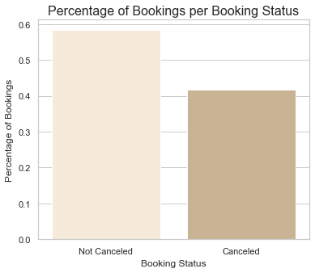
02
EXPLORATORY
DATA ANALYSIS
41.7%

Slide 9
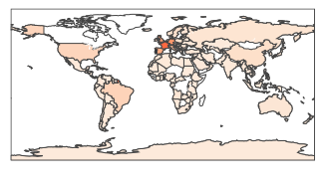
02
EXPLORATORY
DATA ANALYSIS
WHERE ARE THE CUSTOMERS FROM?
TOP 3 COUNTRIES
CANCELATION RATES
BOOKINGS
OF THE TOP 3
31K
65 %
PORTUGAL
8.8K
20 %
FRANCE
6.1K
18 %
GERMANY

Slide 10
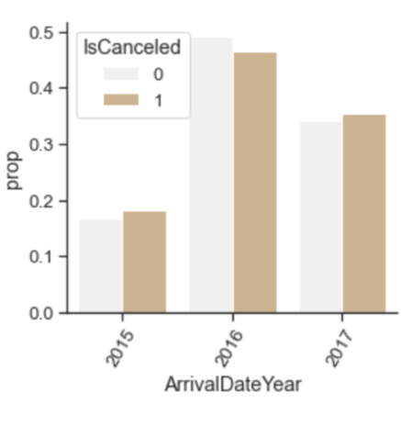
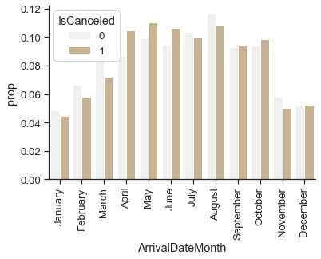
02
EXPLORATORY
DATA ANALYSIS

Slide 11
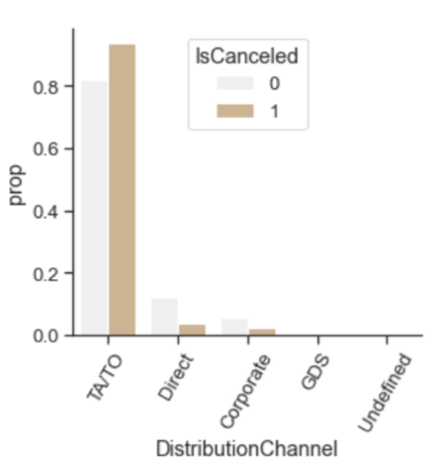
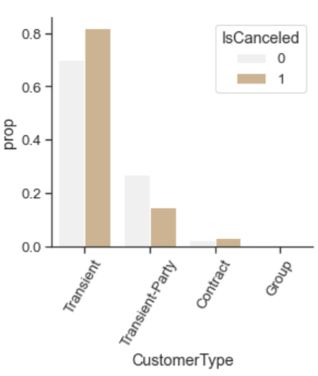
02
EXPLORATORY
DATA ANALYSIS

Slide 12
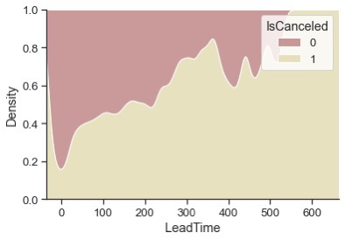
02
EXPLORATORY
DATA ANALYSIS

Slide 13
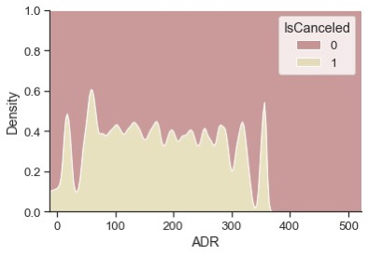
02
EXPLORATORY
DATA ANALYSIS

Slide 14
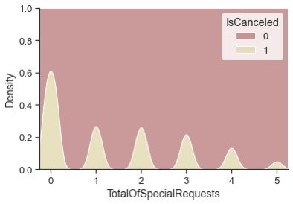
02
EXPLORATORY
DATA ANALYSIS

Slide 15
01
02
03
BUSINESS UNDERSTANDING
EXPLORATORY DATA ANALYSIS
04
05
DATA
PREPARATION
MODELING
MODEL
DEPLOYMENT

Slide 16
DATA PREPARATION
03
Cleaned the data:
dropped duplicates
dropped irrelevant features
substituted missing values with modes
trimmed outliers
encoded the categorical features
with OneHotEncoding
Created new features:
TotalStayNights
StaysInWeekendNights + StaysInWeekNights
TotalGuestsNumber
Adults, Children + Babies
ReservedRoomChanged
checking whether ReservedRoomType and AssignedRoomType were the same
TotalPreviousCancellationsRate
PreviousCancellations and total stays

Slide 17
01
02
03
BUSINESS UNDERSTANDING
EXPLORATORY DATA ANALYSIS
04
05
DATA
PREPARATION
MODELING
MODEL
DEPLOYMENT

Slide 18
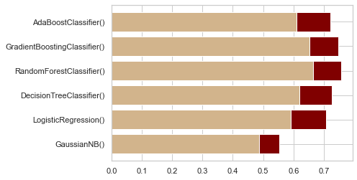
MODELING
04
BINARY CLASSIFICATION
F1 SCORE
ACCURACY

Slide 19
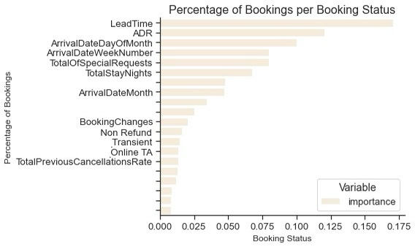
MODELING
04
FEATURE IMPORTANCE

Slide 20
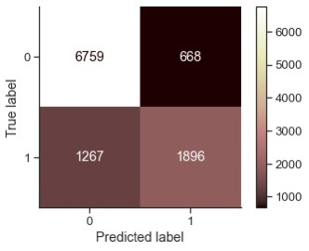
MODELING
04
CONFUSION MATRIX

Slide 21
01
02
03
BUSINESS UNDERSTANDING
EXPLORATORY DATA ANALYSIS
04
05
DATA
PREPARATION
MODELING
MODEL
DEPLOYMENT

Slide 22
MODEL
USE
MAINTAIN
Random Forest Classifier
Daily update of cancellation rates
05
MODEL
DEPLOYMENT
Train monthly with new data
Predicts cancellation rate of future bookings
estimate net demand
Adjust overbooking measures
Special offers
Increase precision of model over time

Slide 23
Q CONSULTING
Q CONSULTING
For questions and concerns, contact us at
info@q-consulting.com
Copyright © 2022 Q CONSULTING. All rights reserved.

